Slide 1
Green Cross Code
Road Safety
Think back
Have you been or nearly been in a road accident?
Get ready for a show of hands

Slide 2
Teacher instructions
To measure road safety progress, use the progress sheet at start and the end of the task. Column 1 answers at the start, column 2 answers at the end.
Talk to the children about the green cross code and road safety and why it is important, slides 3-12. Each day in the UK 6 children are killed or seriously injured due to road incidents, that is one class per week! Source: www.brake.org.uk. The worksheet supports these slides.
Introduce coding and BBC micro:bits, hand out the resources, give them a demonstration if needed, children write code, download, try out actions with micro:bit. Ask how could change it to make it better. Slides 13-18
Talk to children about road safety, asking questions to help with progress sheet, and why this is important. Children complete sheet.
To erase the code for the next class, ask the children to program the micro:bit again, this time using the Basic Tab: On start, they can choose a string or icon, e.g., heart or “hi”, and download this to the Micro:bit.

Slide 3




Crossing the Road – put the steps in the correct order
Notes:
Crossing the Road – put the cards in the correct order
The cards are
Look, Think, Listen, Stop

Slide 4


Crossing the Road – put the cards in the correct order
Notes:
The answer is
Stop, Look, Listen, Think
If we do this every time we cross the road, even as an old person, it will keep us safe. So we can carry on with the rest of our day and not end up in hospital.

Slide 5
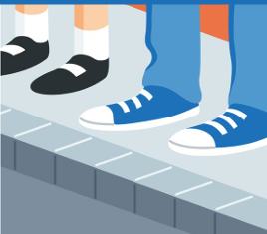
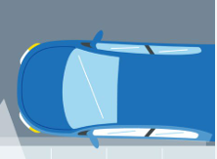
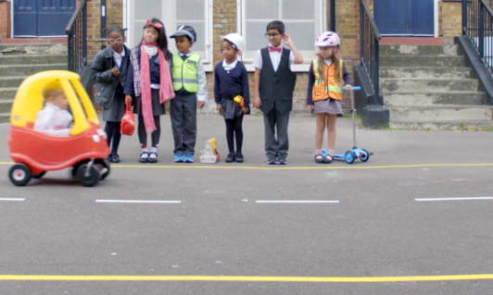
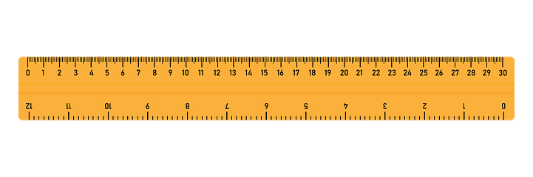
Stop
30cm
back from edge
Good view of moving traffic
Protects you from wing mirrors
Notes:
Stop
When we stop, we should stand about 30cm away from the edge of the road. This will stop car wing mirrors from hitting us, if a car drives close to the path. We should stop where we have a clear view of all the moving traffic.

Slide 6
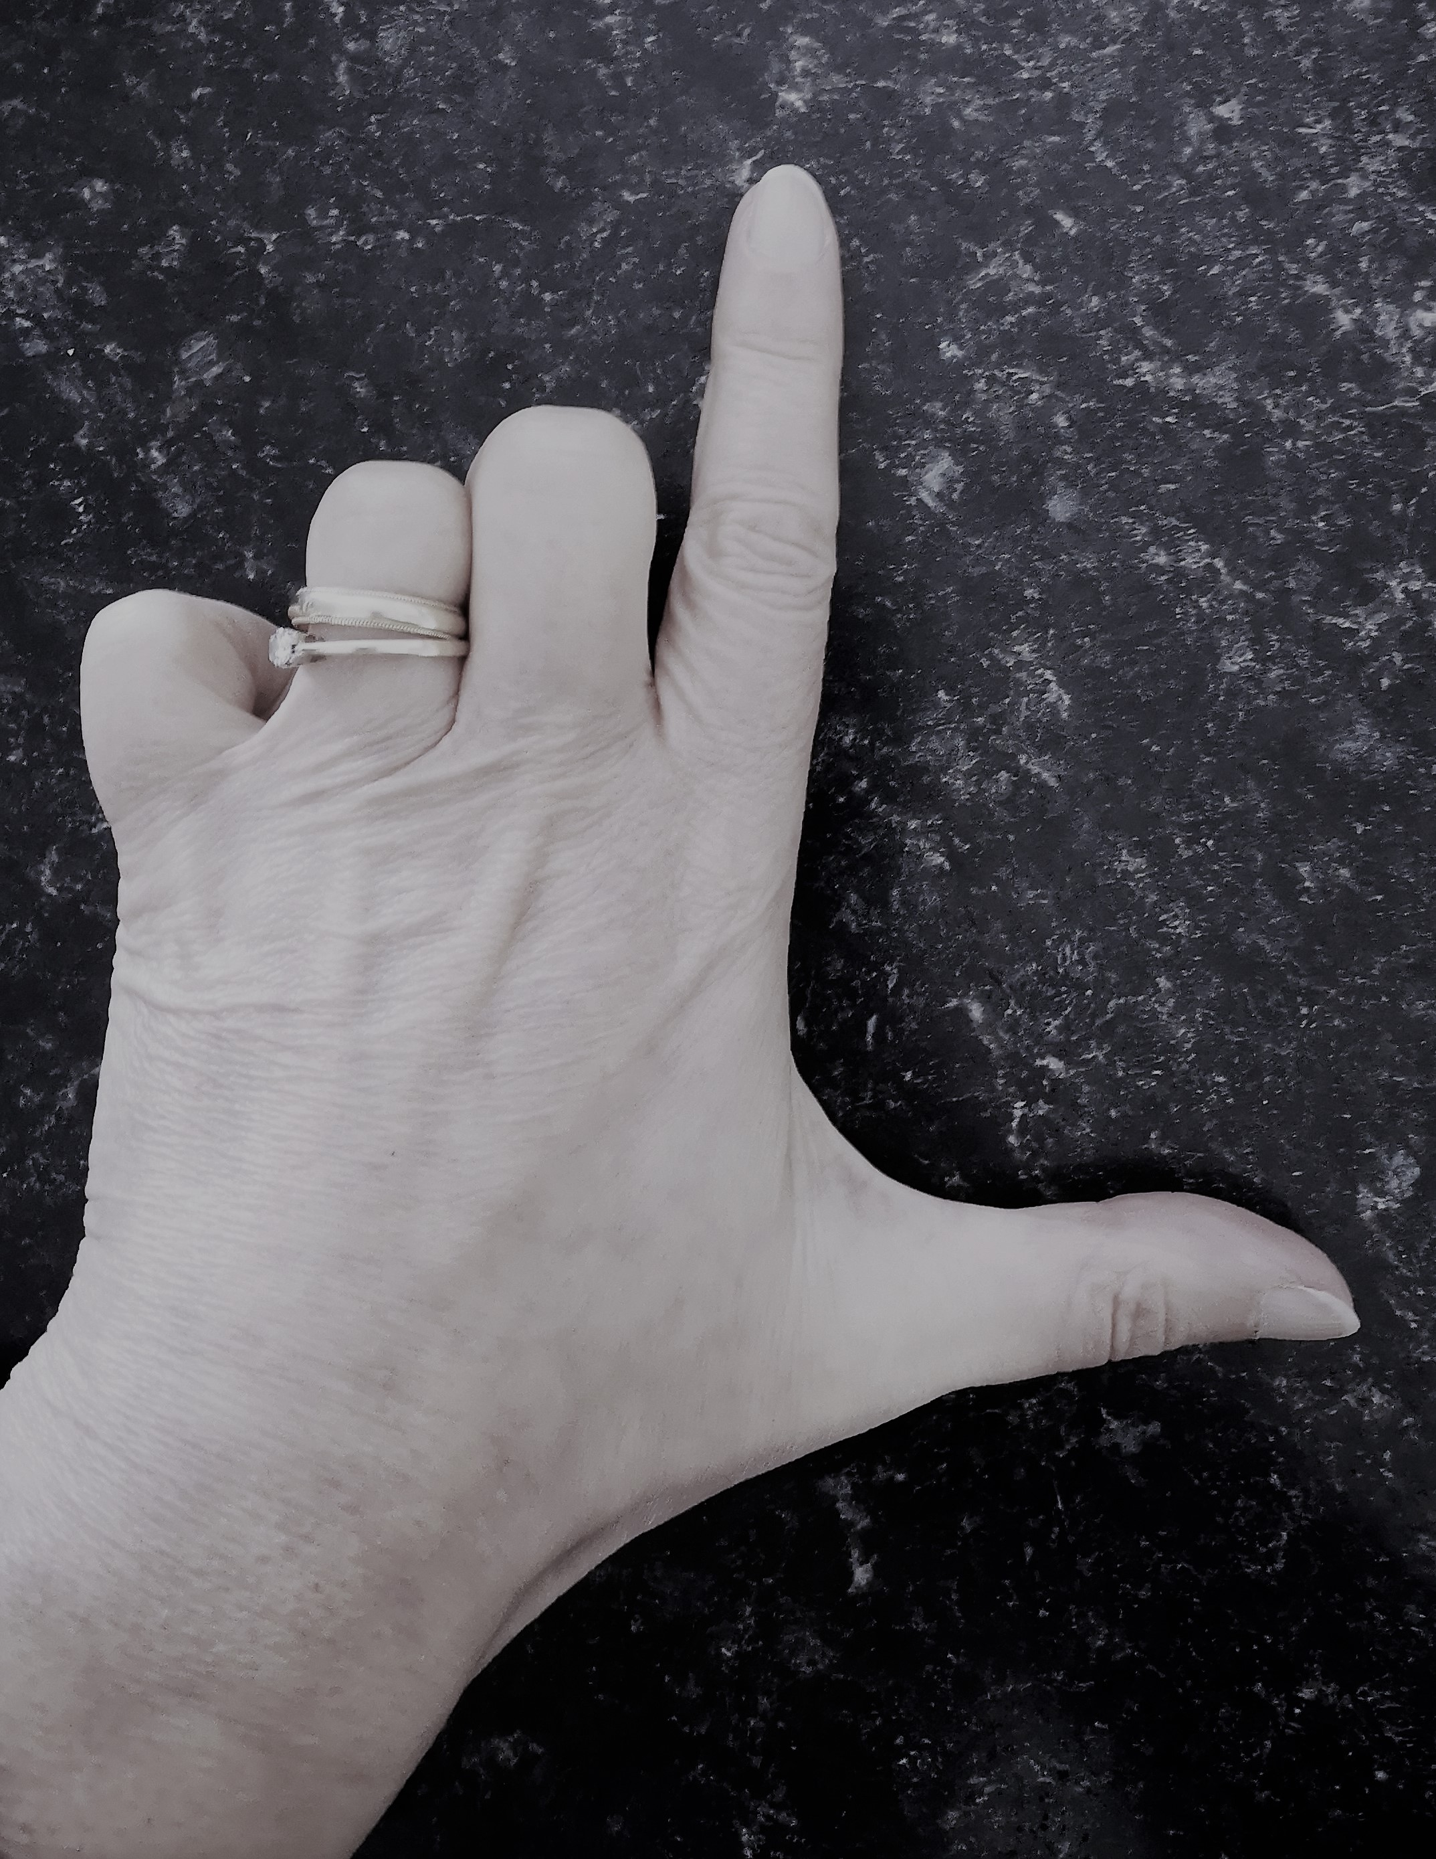

Look
Hold up your left hand. How do you know this is your left hand?
Notes:
Look
Do you know which way to look when crossing the road? Ask children to hold up their right hand and then their left. The image shows the left hand and the letter L. The other hand is your right hand.

Slide 7
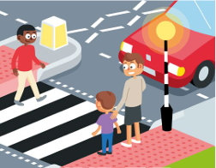
Look
Where is your nearest danger when crossing the road?
Look Right
Look left
Look Right Again
Notes:
Look
Where is your nearest danger when crossing the road? From the right, that is why we say the sequence Look right, Look Left, Look right again.
But we need to look in all directions, where moving traffic might come from when crossing the road
Looking in all directions is very important, especially with more electric cars that we cannot hear.

Slide 8

Listen
What traffic sounds can you hear?
Which traffic sound would not be on the road?
At a lights crossing, even though the green man is showing, and traffic has stopped. What vehicle noise, would stop you crossing the road?
Listen to the sounds and answer the questions
Notes:
Listen to the sounds and answer the questions
What traffic sounds can you hear?
Which traffic sound would not be on the road?
Which traffic sounds, would stop you crossing the road, even at a zebra or lights crossing?

Slide 9
Listen
Answers
What traffic sounds can you hear
Police, Bicycle, Ambulance, Lorry, Motorbike, Train
2. Which traffic sound would not be on the road? Train
3. At a lights crossing, even though the green man is showing, and traffic has stopped. What vehicle noise, would stop you crossing the road? Emergency vehicles: fire, police, ambulance
Listen to the sounds and answer the questions
Notes:
Answers to Listen to the sounds and answer the questions:
What traffic sounds can you hear
Car, Fire Engine, Bus / Lorry, Police, Bicycle, Tractor, Ambulance, Train, Motorbike
2. Which traffic sound would not be on the road? Train
3. Which vehicle noises, would stop you crossing the road, even at a zebra or lights crossing? Answer Emergency vehicles: fire, police, ambulance

Slide 10

Think
Is it safe to cross
Am I making a good choice
Remember to keep looking and listening as you cross.
When crossing the road, which is safer?
Walk
Run
Go straight across
Go diagonal
Notes:
Think
When crossing we think
Is it safe to cross
Am I making a good choice
Question: When Crossing the road which is it safer to do?
Walk or Run? Answer: Walk, you are less likely to trip
Walk straight across or walk diagonally? Answer walk straight across. You will be on the road for less time.

Slide 11
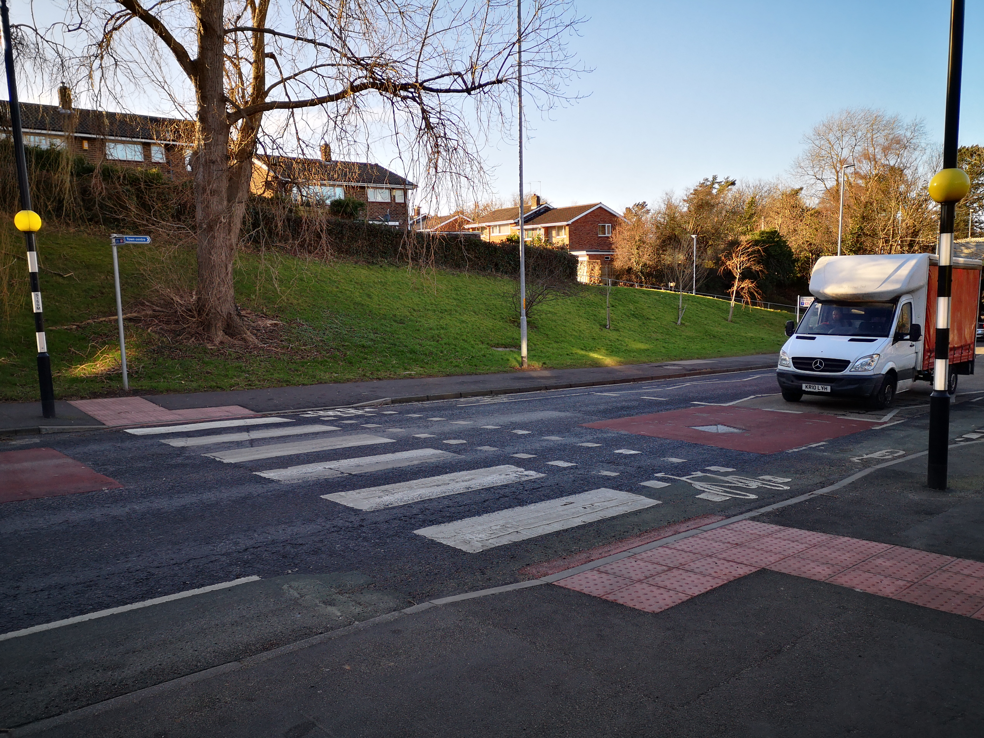
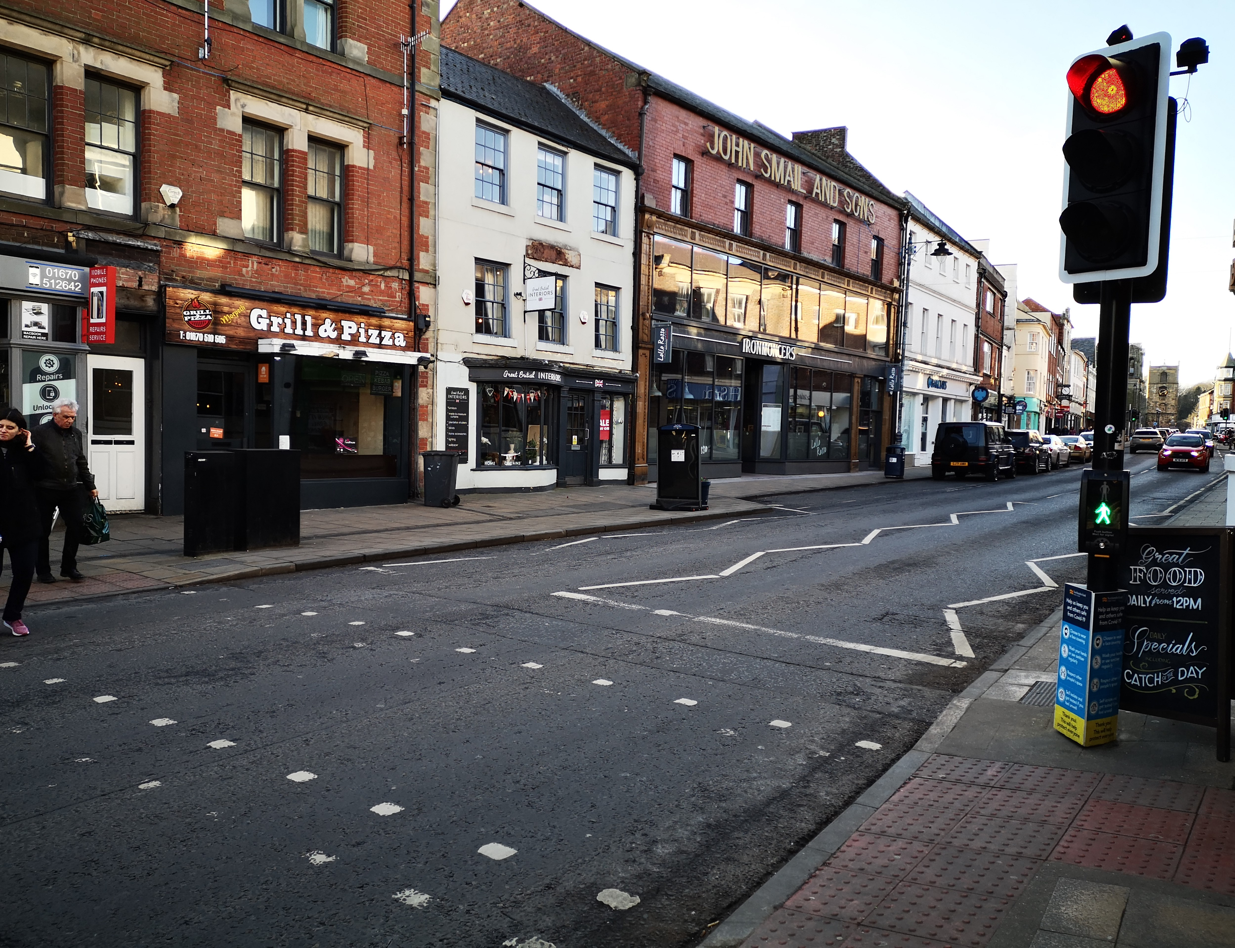
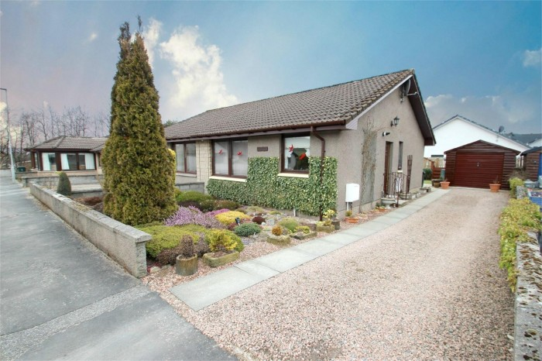
When crossings at these places, what simple sequence must you use to protect yourself?
Notes:
When crossing at a zebra crossing, a lights crossing, or crossing a driveway, what should you still use?
The Green Cross Code: stop, look, listen, think

Slide 12

Always use the Green Cross Code, when crossing the road
Write some tips on the worksheet to help you remember what to do when crossing the road.

Slide 13
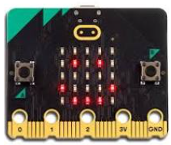
Green Cross Coding
Task: You will create the action code for the road safety sequence. Download this to a BBC Micro:bit and test the these on the mini computer.
Coding Key Words:
Code - Code makes things happen on a computer.
BBC Micro:bit - tiny handheld programmable computers, that have small led lights, motion sensors and they can be hooked up to other devices through cables and Bluetooth technology.

Slide 14
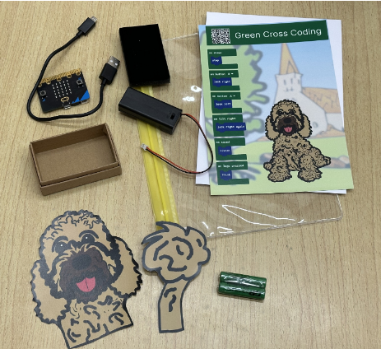
Resources
Laptop / Computer
BBC Micro:bit
Battery pack and batteries
Cable – (USB C / USB B ends)
Green Cross Coding Card

Slide 15
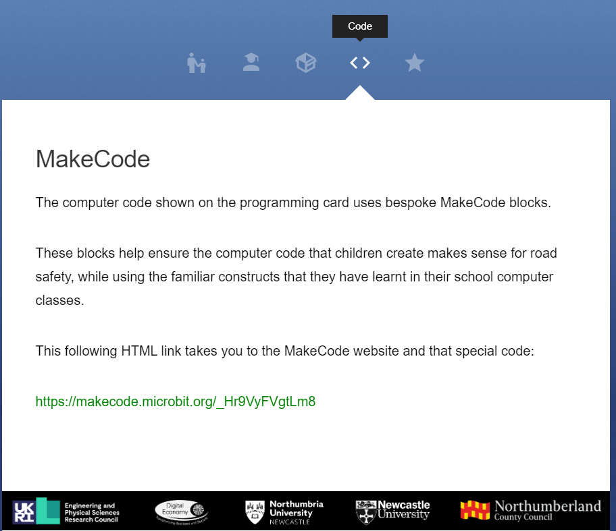
Method 1 – Getting Started
Log on to www.greencrosscoding.com
Go to Code Tab, select the hyperlink
Put batteries into battery pack
Attach battery pack to Micro:bit, make sure it is the correct way round
Add USB cables to computer and Micro:bit
Green Cross Coding Instruction Sheet

Slide 16
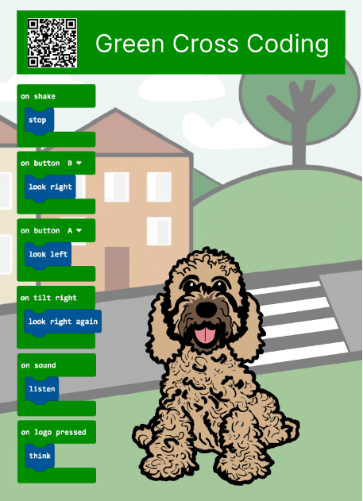

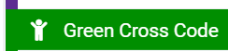
Method: Coding
Click on Edit Code button
Select Green Cross Code Tab
Make code – see card
Download to Micro:bit
Try out actions, try to get the correct sequence
How would you change the code, to make it better?
Notes:
Teacher to demonstrate dragging instructions

Slide 17
Return equipment
Please return all the wires, battery pack, micro:bit to their box, with band and hand in to your teacher.
Hand in the progress sheets and Green cross coding cards

Slide 18
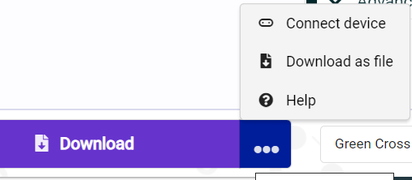
Problem Solving
Downloads not working
Check all plugged in
Select 3 dots next to download. Click connect device.
Then download again.

Slide 19
Green Cross Code Learning
Look at the progress sheet, what answers do you know now?
What do you need to ask questions about to help you stay safe? Ask your teacher.
Complete the sheet and hand in.

Slide 20
Extension
Pupils can practice their road safety technique in school or on a road with adult supervision.

